Slide 1
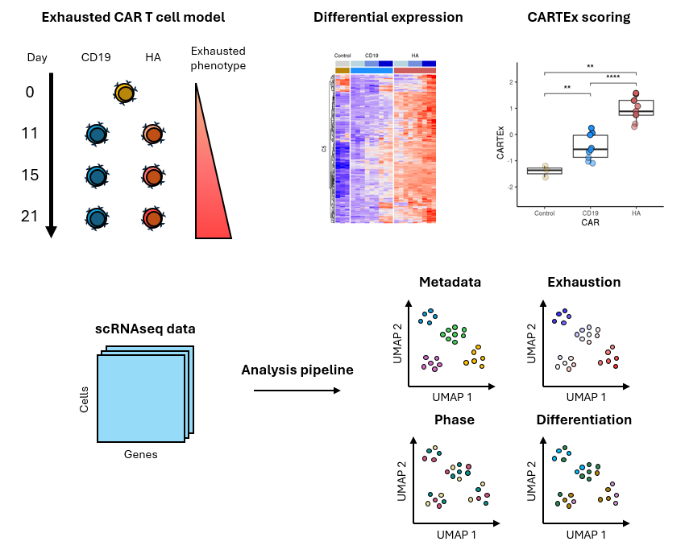
Development of transcriptional signature and scoring of T cell exhaustion from tonically signaling CAR T cells
Graphical abstract

Slide 2
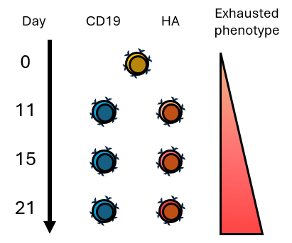
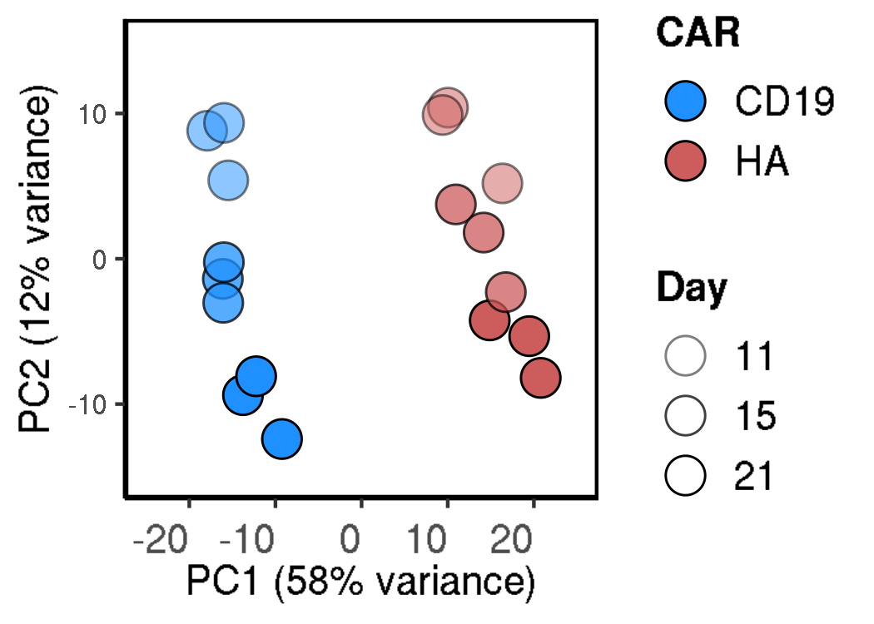
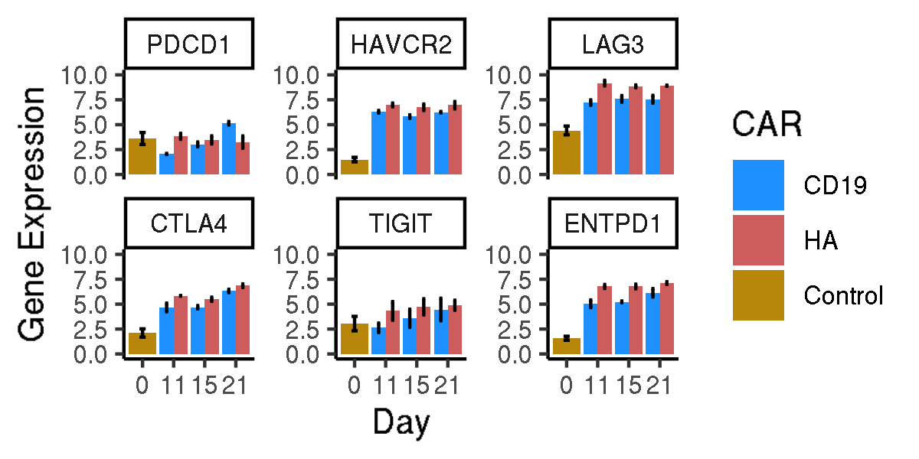
Evaluating CD19 vs HA CAR T cells
Bulk RNA sequencing of sorted functional and exhausted CD8+ CAR T cells across 21 days
Functional vs exhaustion-prone CAR
Principal components
Canonical markers of exhaustion
Notes:
Hello world

Slide 3
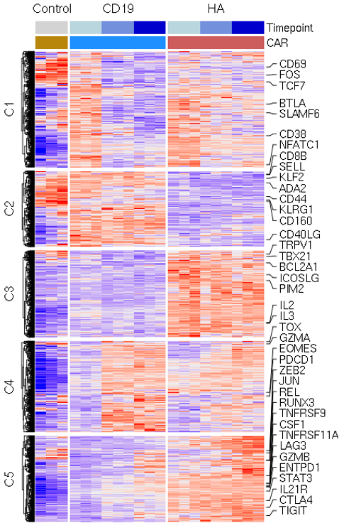
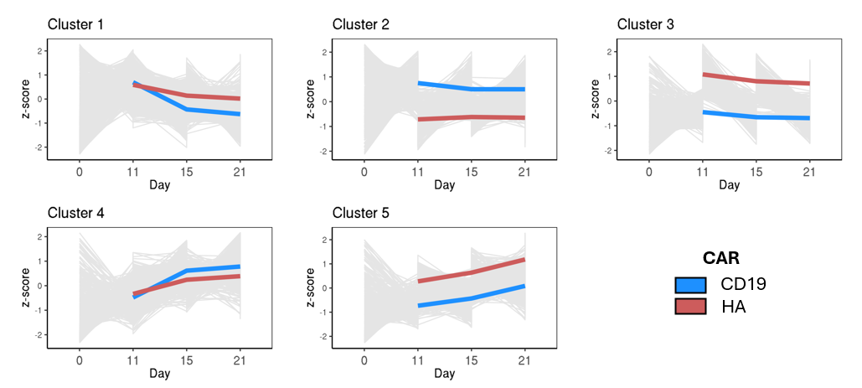
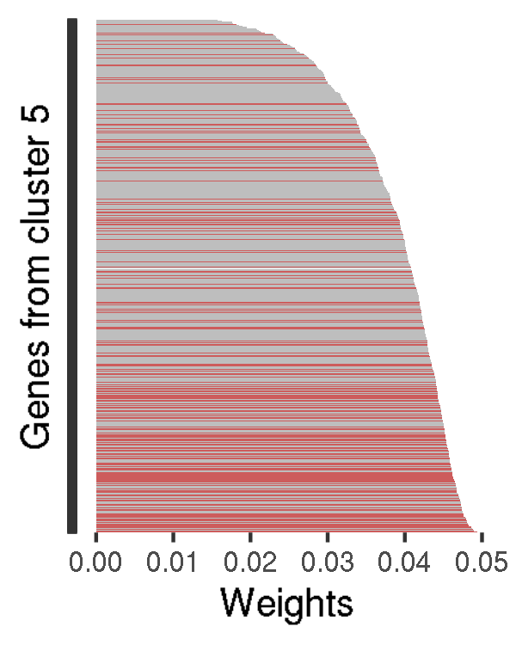
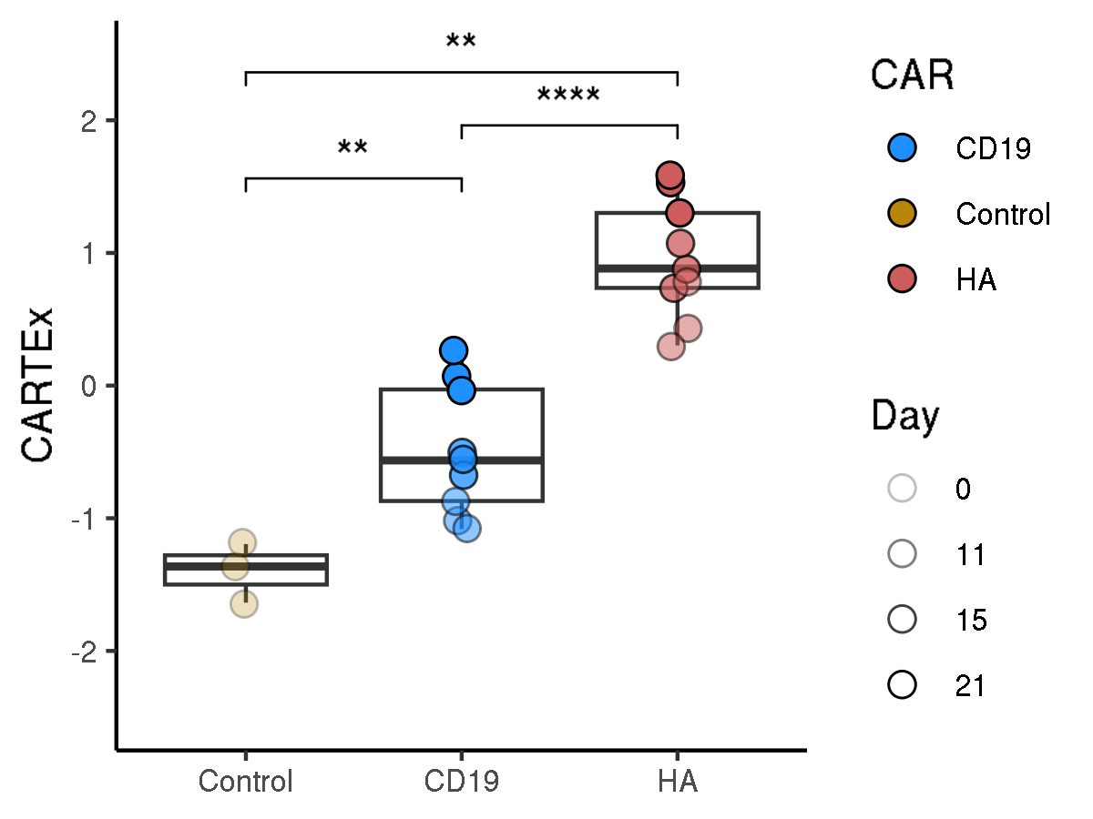
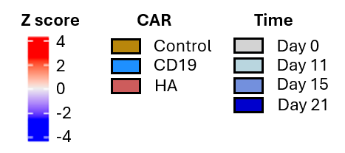
Bulk RNA sequencing of sorted functional and exhausted CD8+ CAR T cells across 21 days
ABC XYZ
Heatmap of gene expression
Clusters of gene expression
Genes of highest variance
CARTEx score
Notes:
Hello world

Slide 4
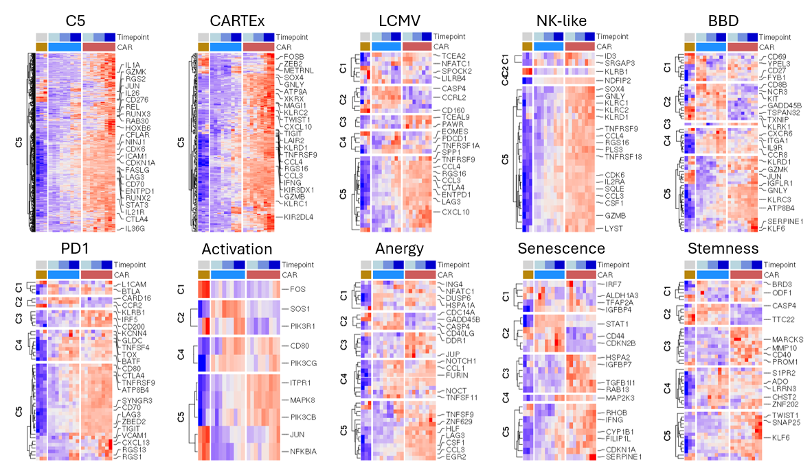
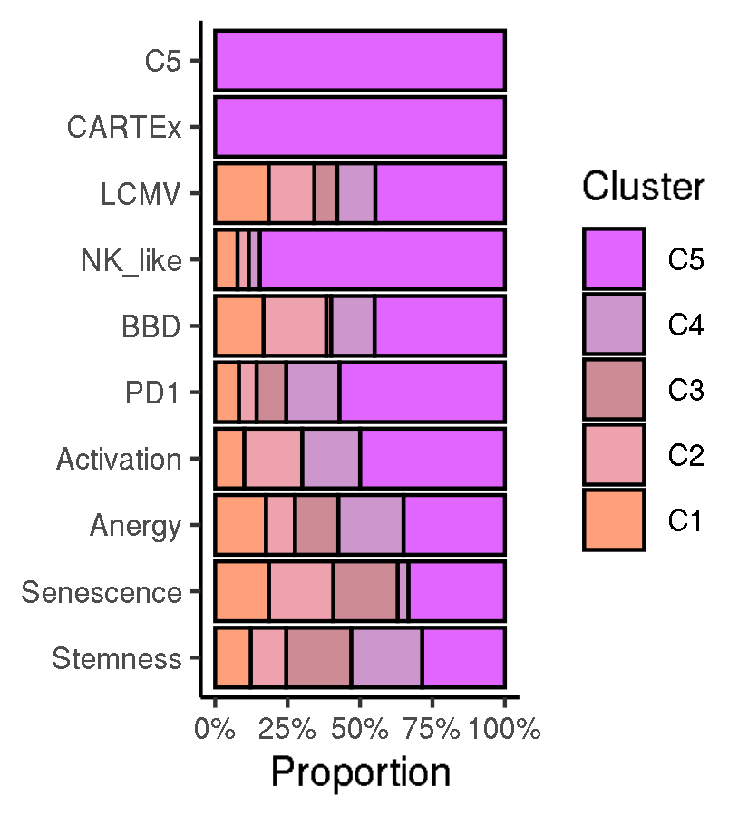
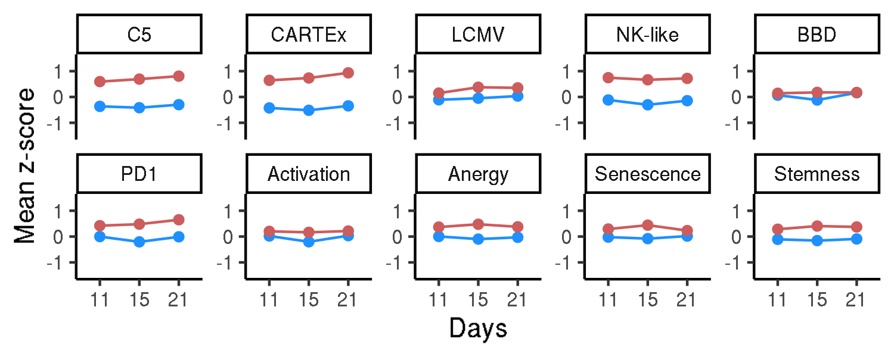
Dissecting the bulk-RNAseq experiment with signatures
Contextualizing the CARTEx signature
Heatmap of gene expression subset by signature
Cluster representation by signature
Mean gene expression by signature
Notes:
Hello world

Slide 5
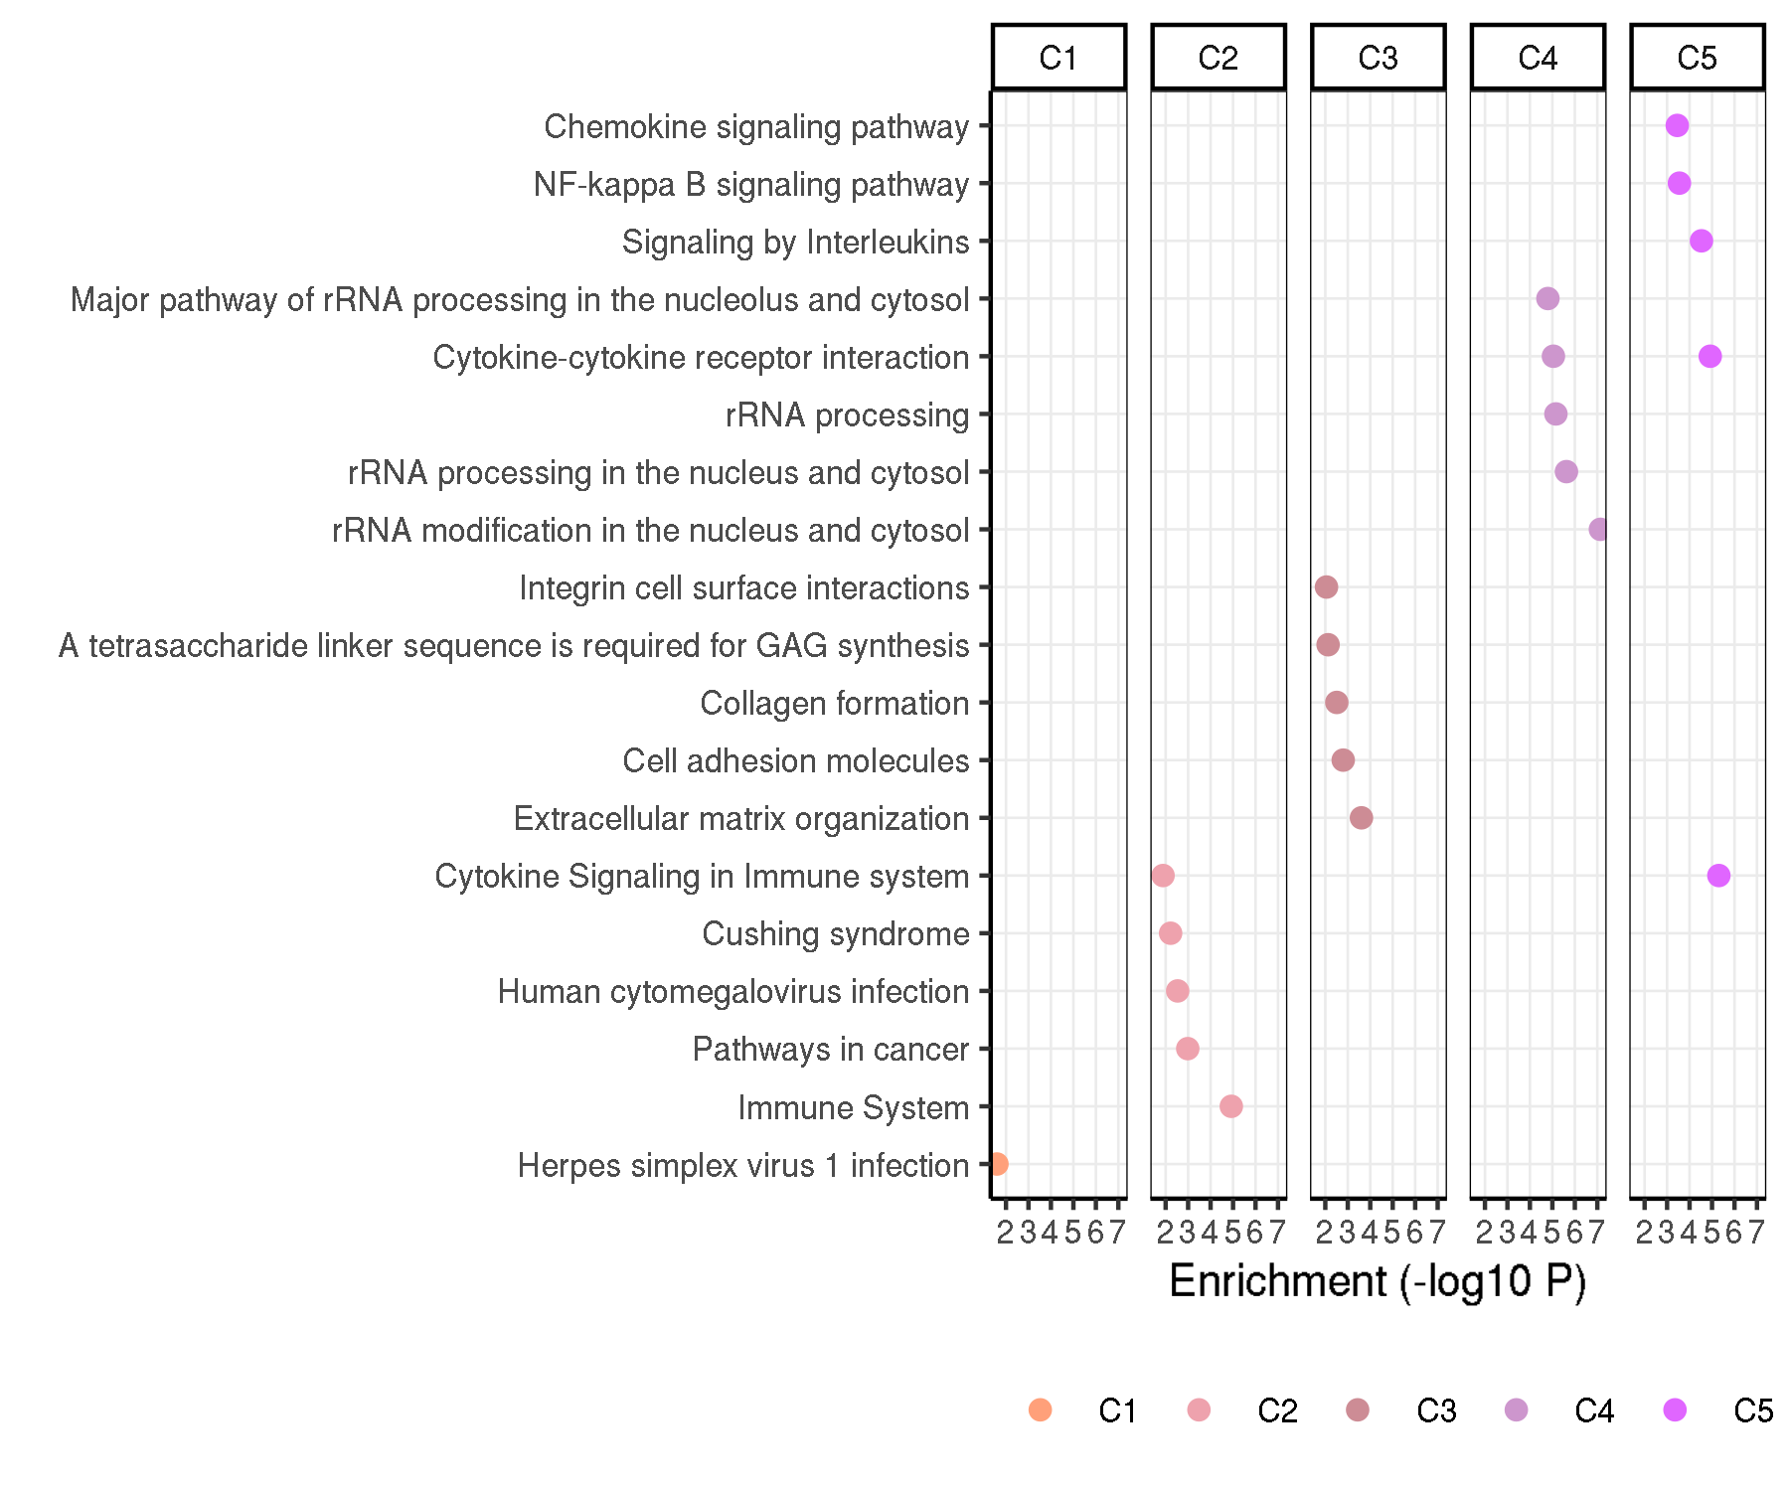
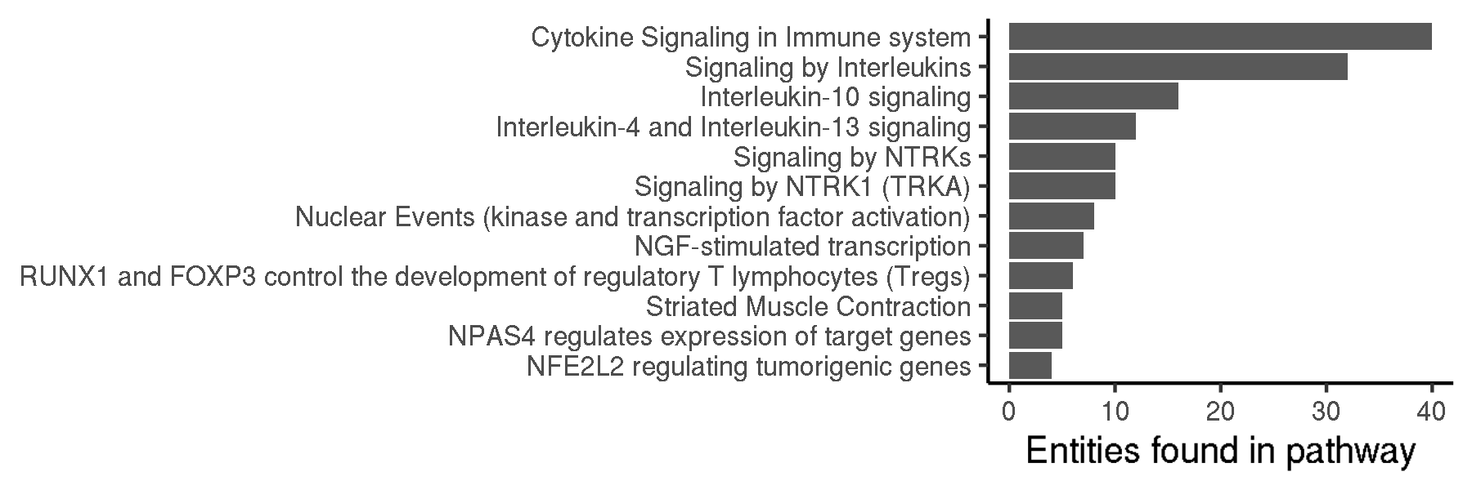
Signaling pathways represented in the CARTEx signature
Contextualizing the CARTEx signature
Enriched pathways by cluster
Enriched pathways in CARTEx
Notes:
Hello world

Slide 6
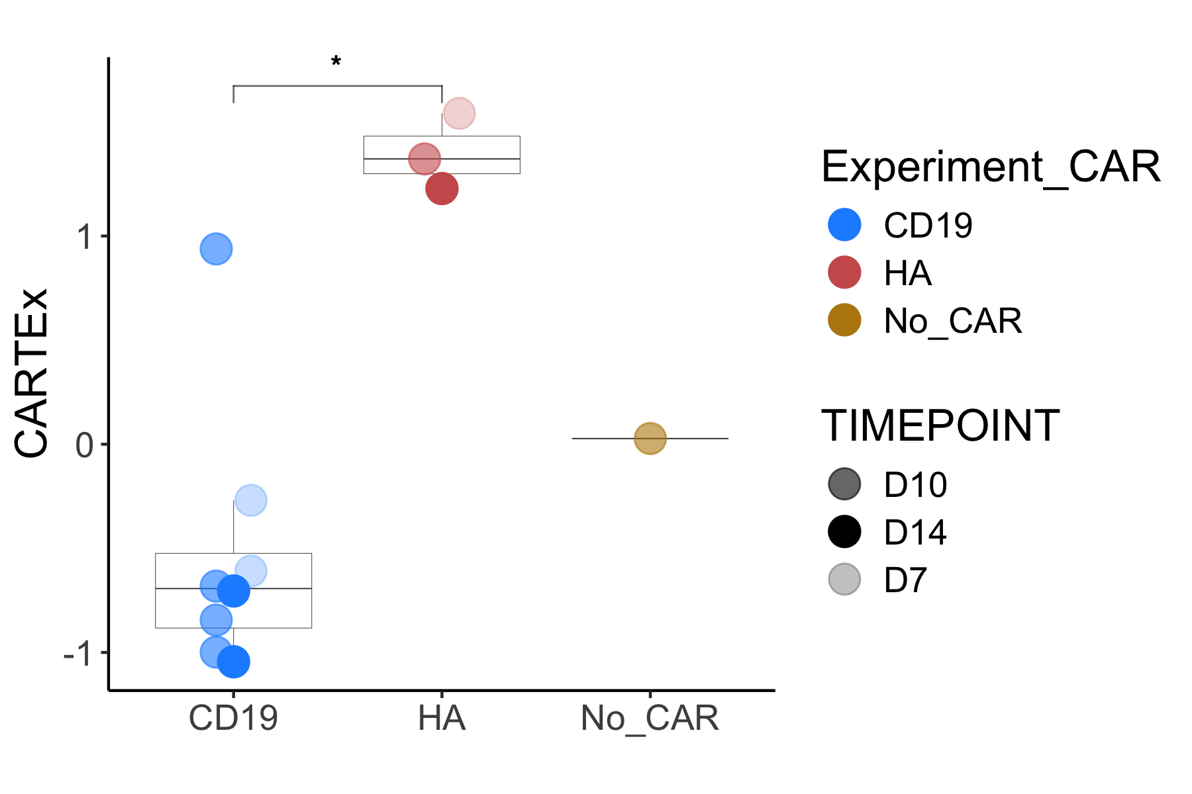
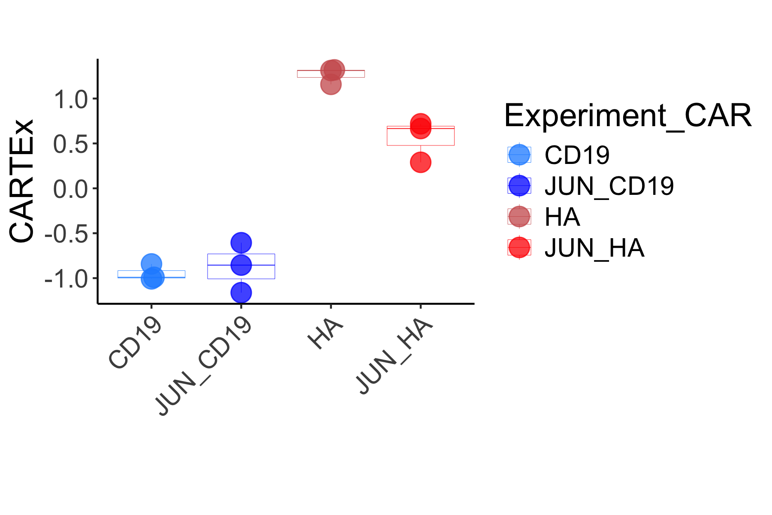
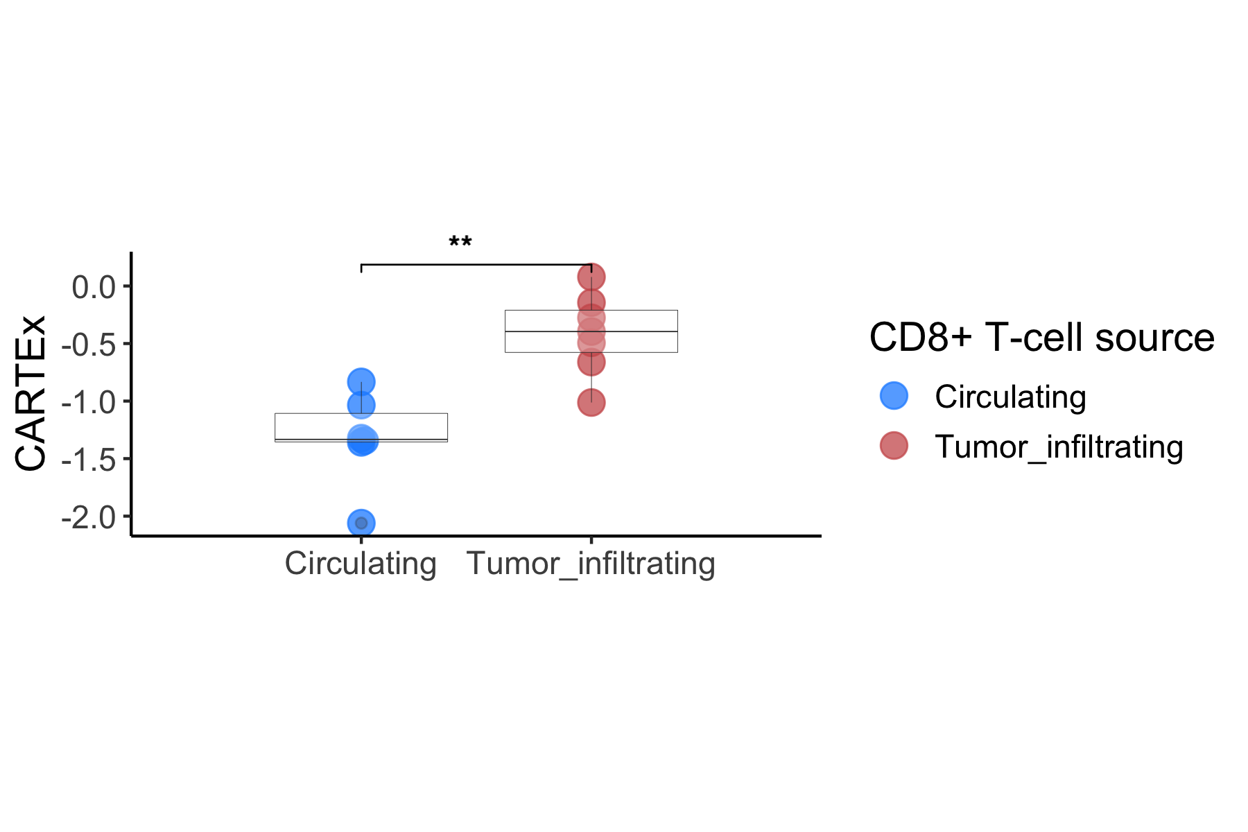
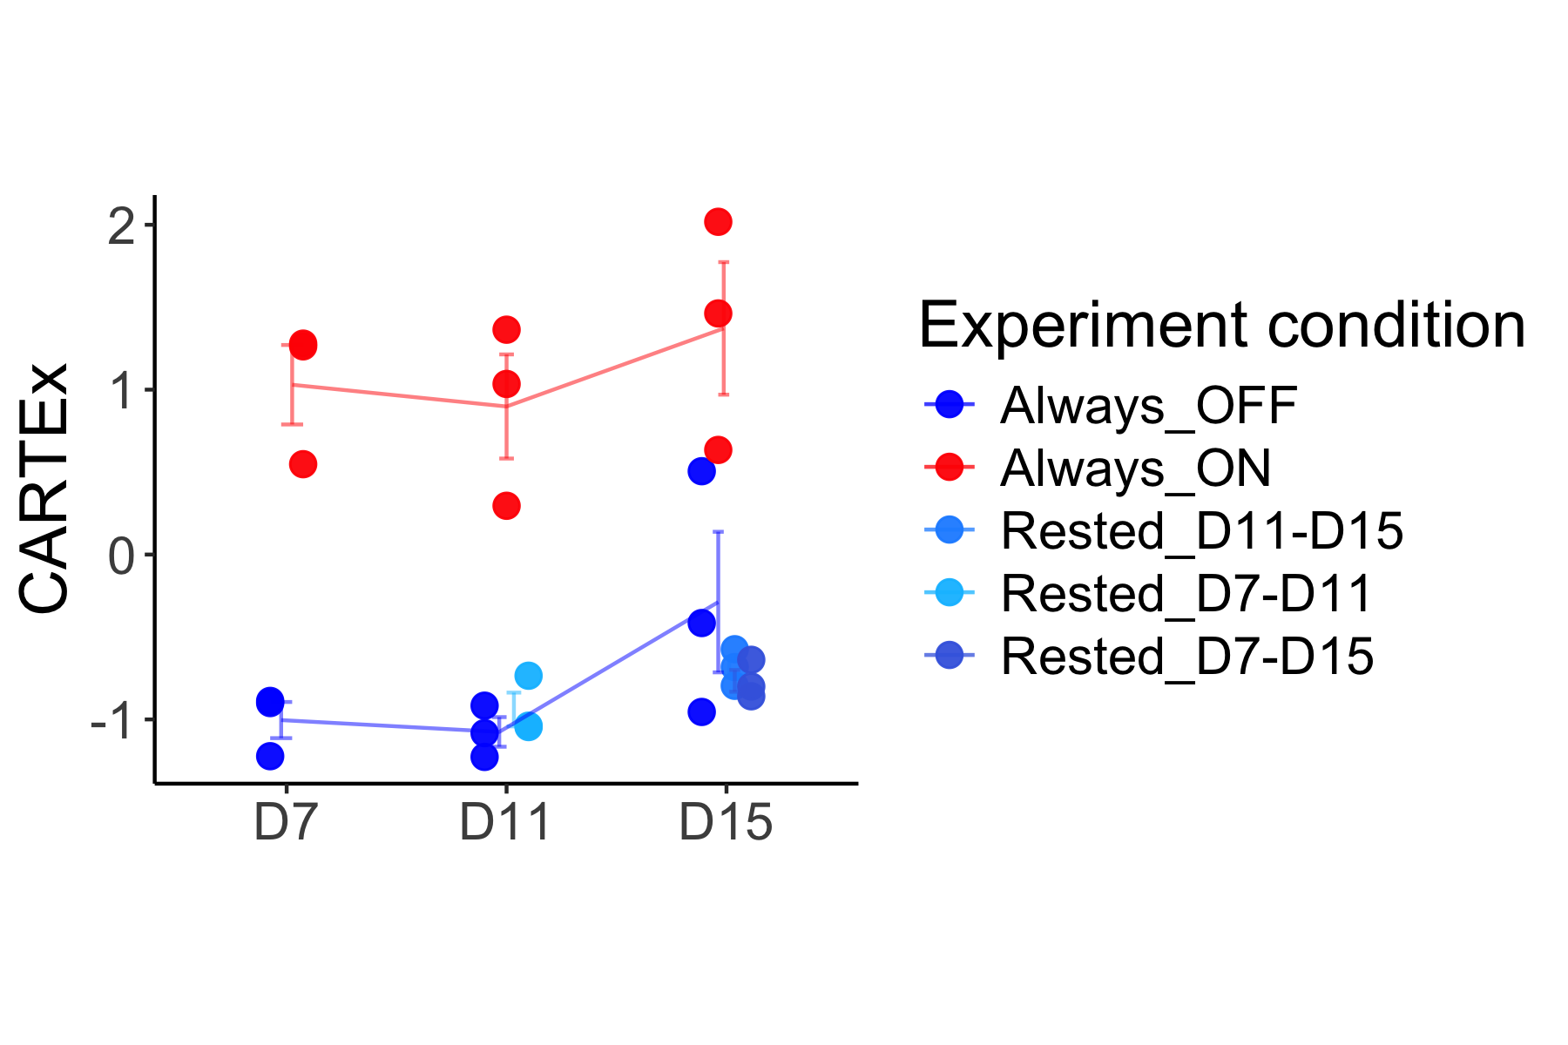
CARTEx scoring of bulk RNA sequencing datasets
Validation of CARTEx signature
Functional vs exhaustion-prone CAR T cells
JUN-overexpression in CAR T cells
Regulatable CAR T cells
Circulating vs TILs
Notes:
Hello world

Slide 7
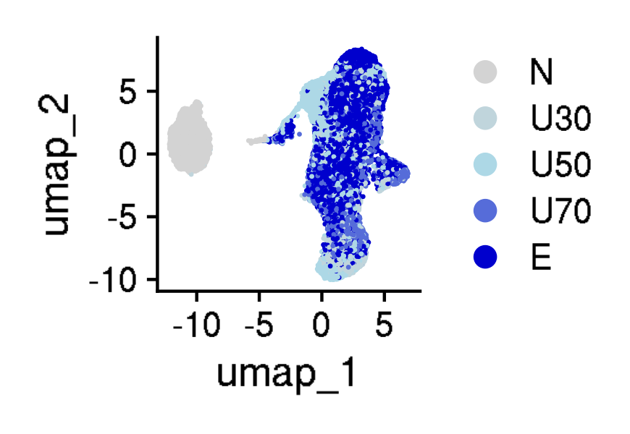
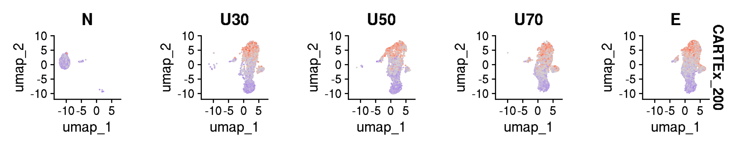
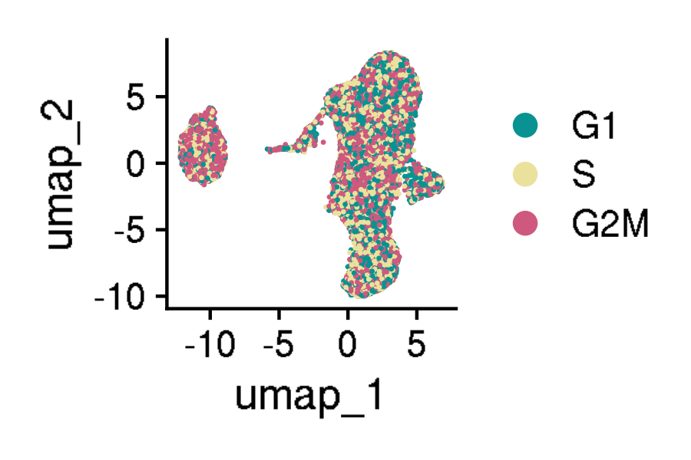
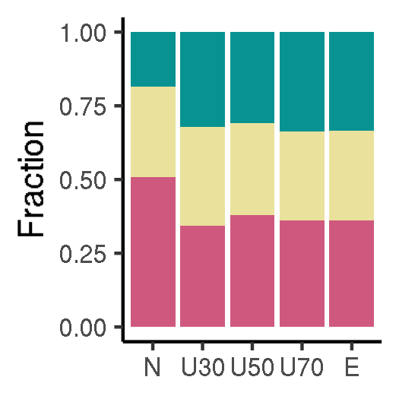
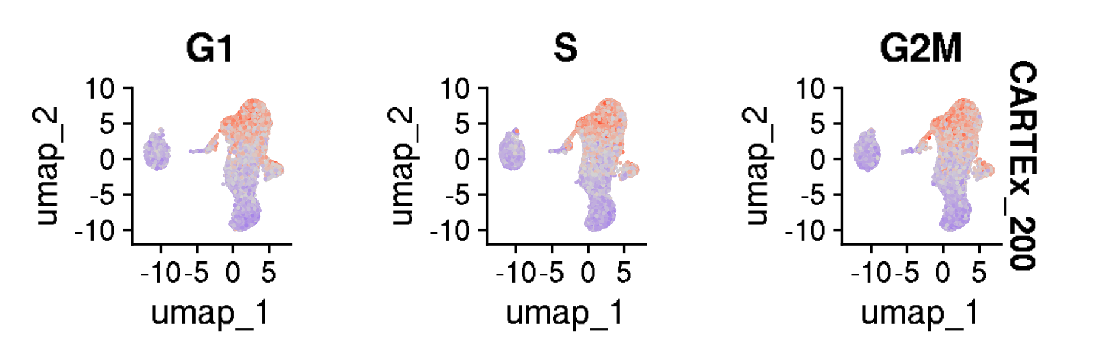
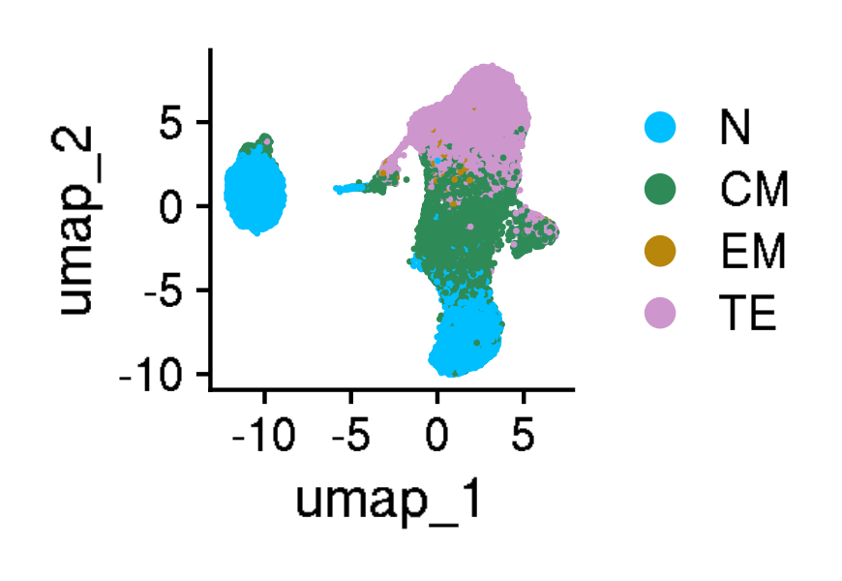
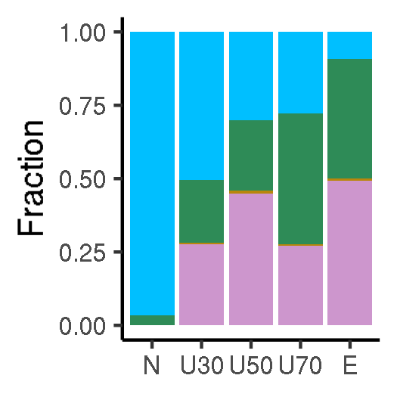
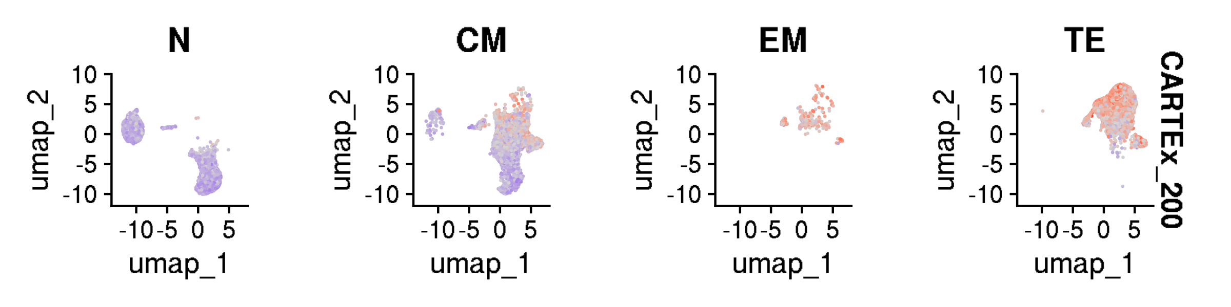
Analysis of cross-sectional aging T cells
GSE136184: 39,937 CD8+ T cells from healthy donors across 9 decades of life
Age group
CARTEx scores split by age group
Cell cycle phase
CARTEx scores split by phase
Cell type differentiation
CARTEx scores split by differentiation
Notes:
Hello world

Slide 8
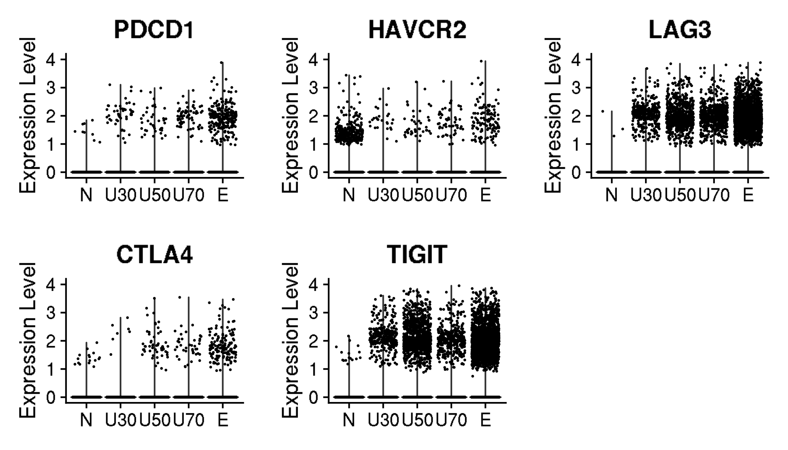
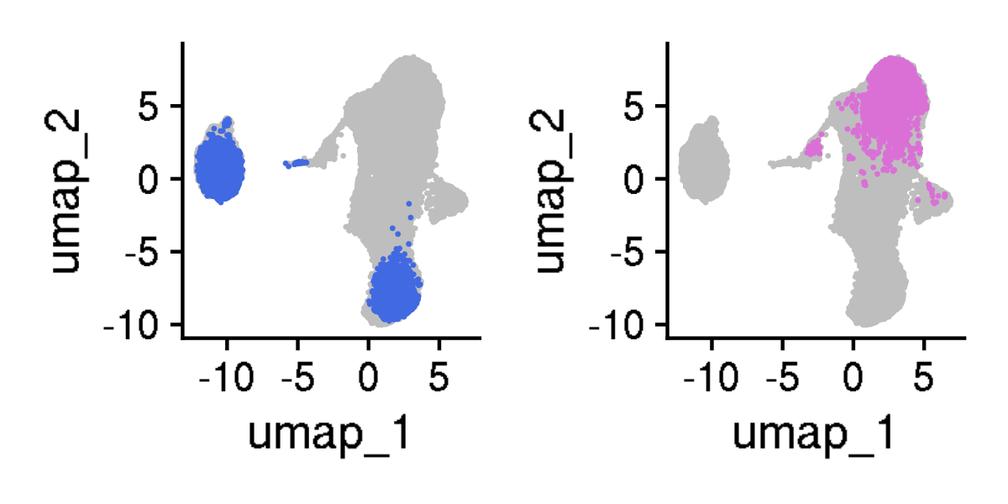
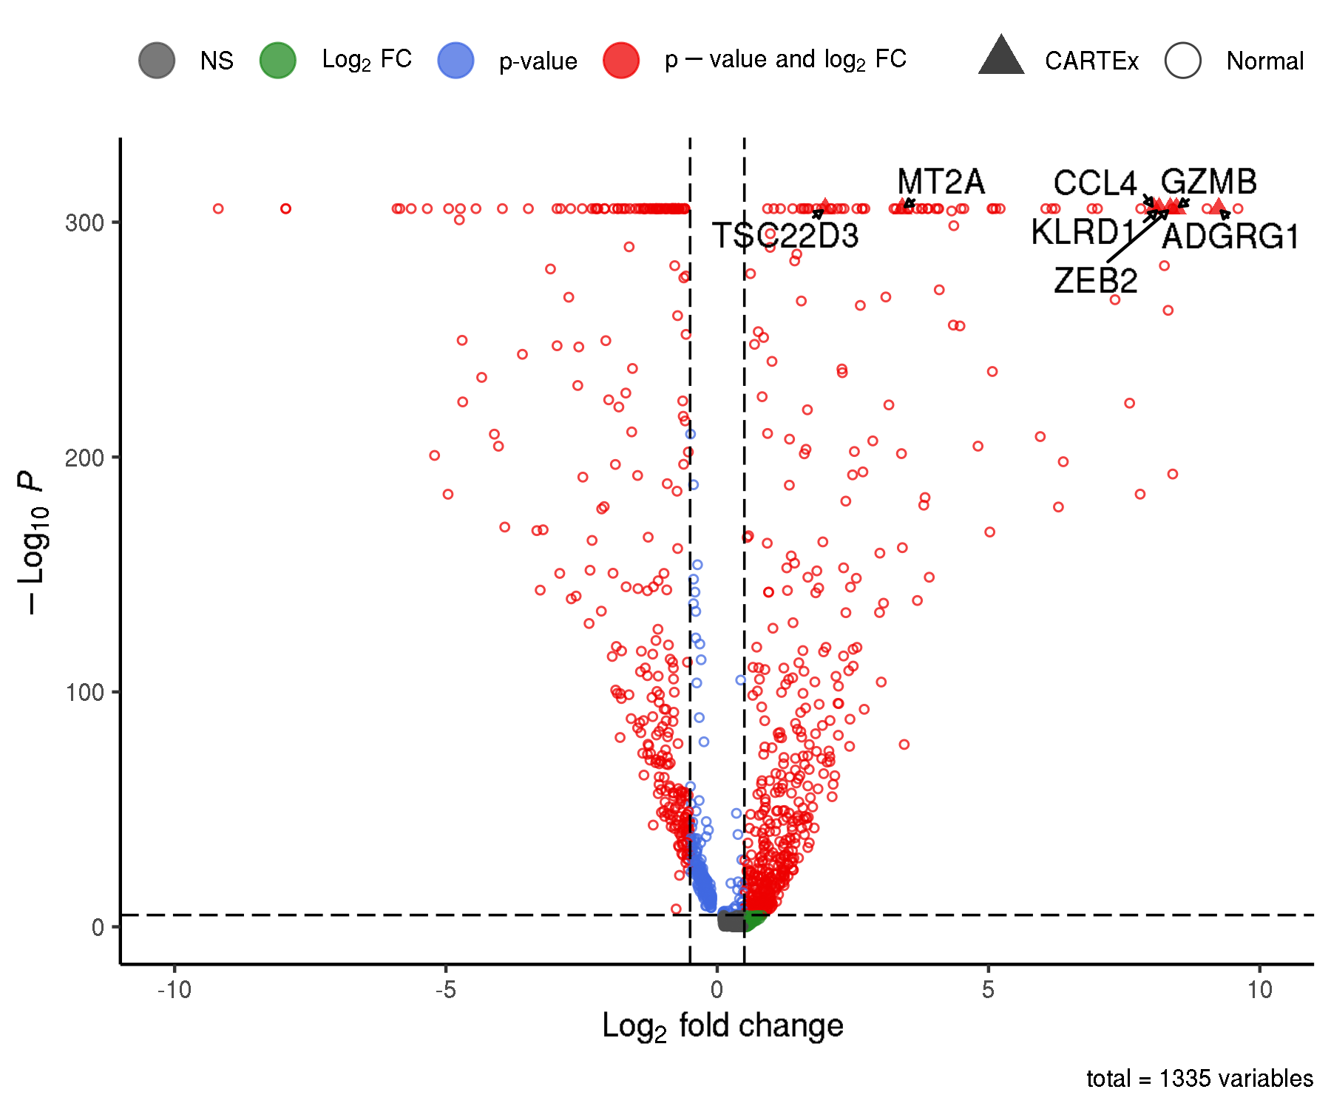
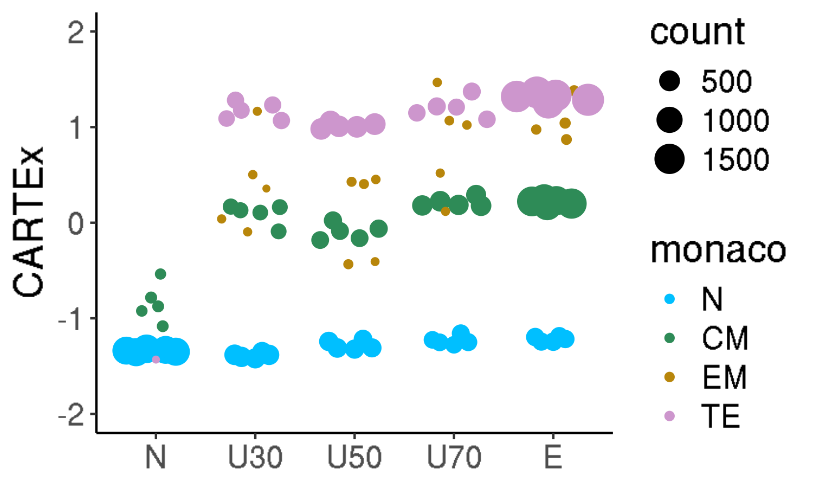
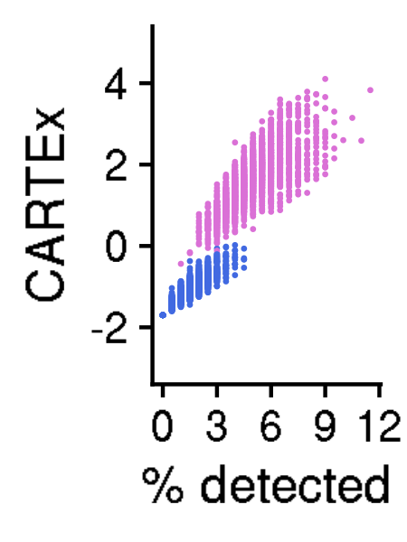
Analysis of 39,937 CD8+ T cells from healthy donors across 9 decades of life
ABC XYZ
Canonical markers of exhaustion
Selected cells for CARTEx markers
Differential gene expression
Pseudo-bulk across differentiation
CARTEx scores for CARTEx markers
Notes:
Hello world

Slide 9
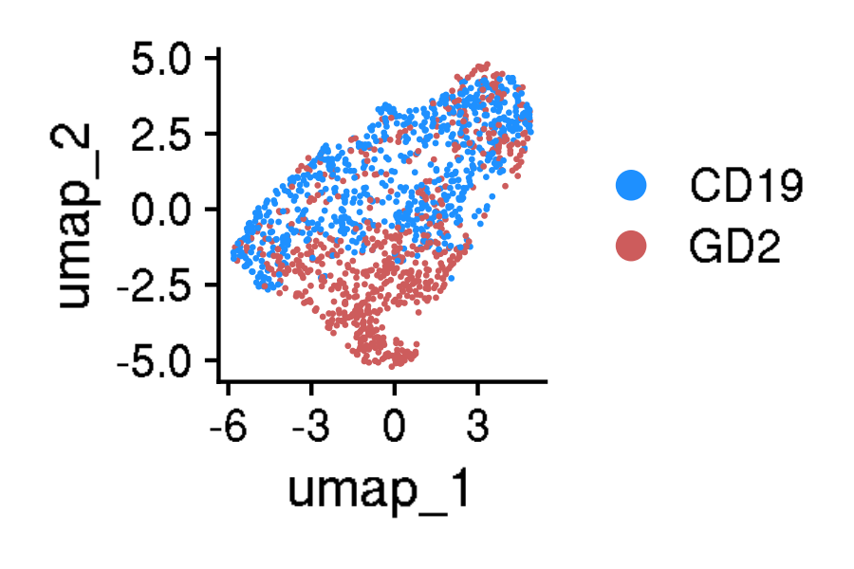
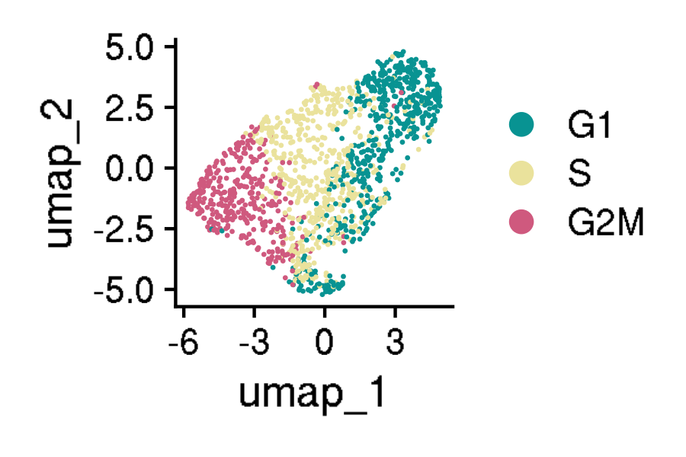
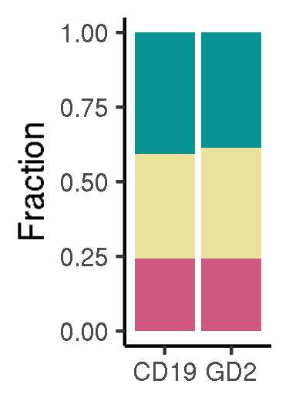
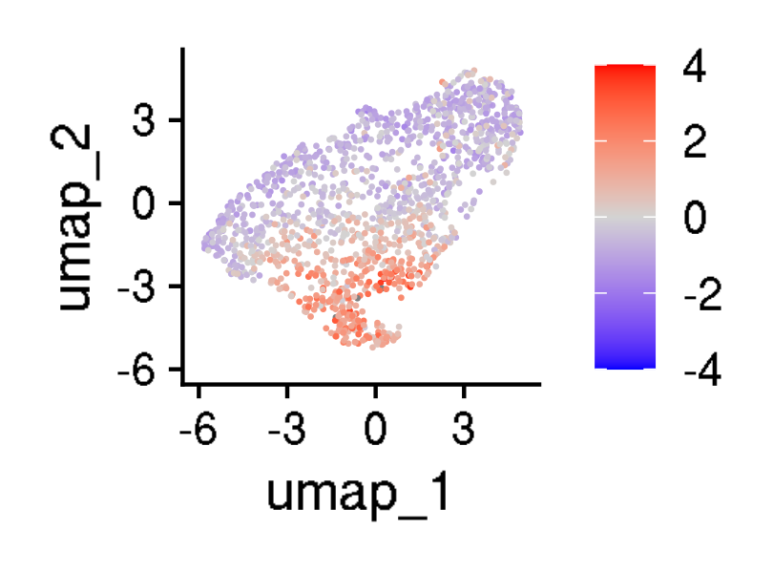
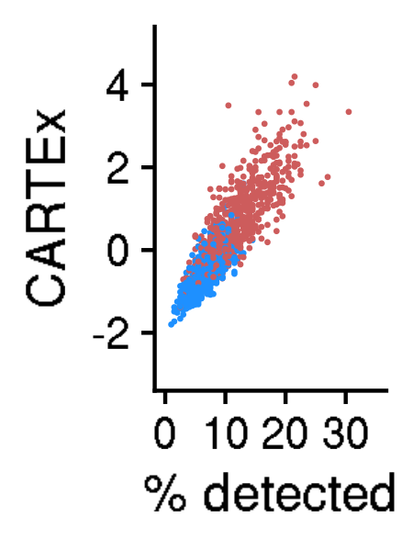
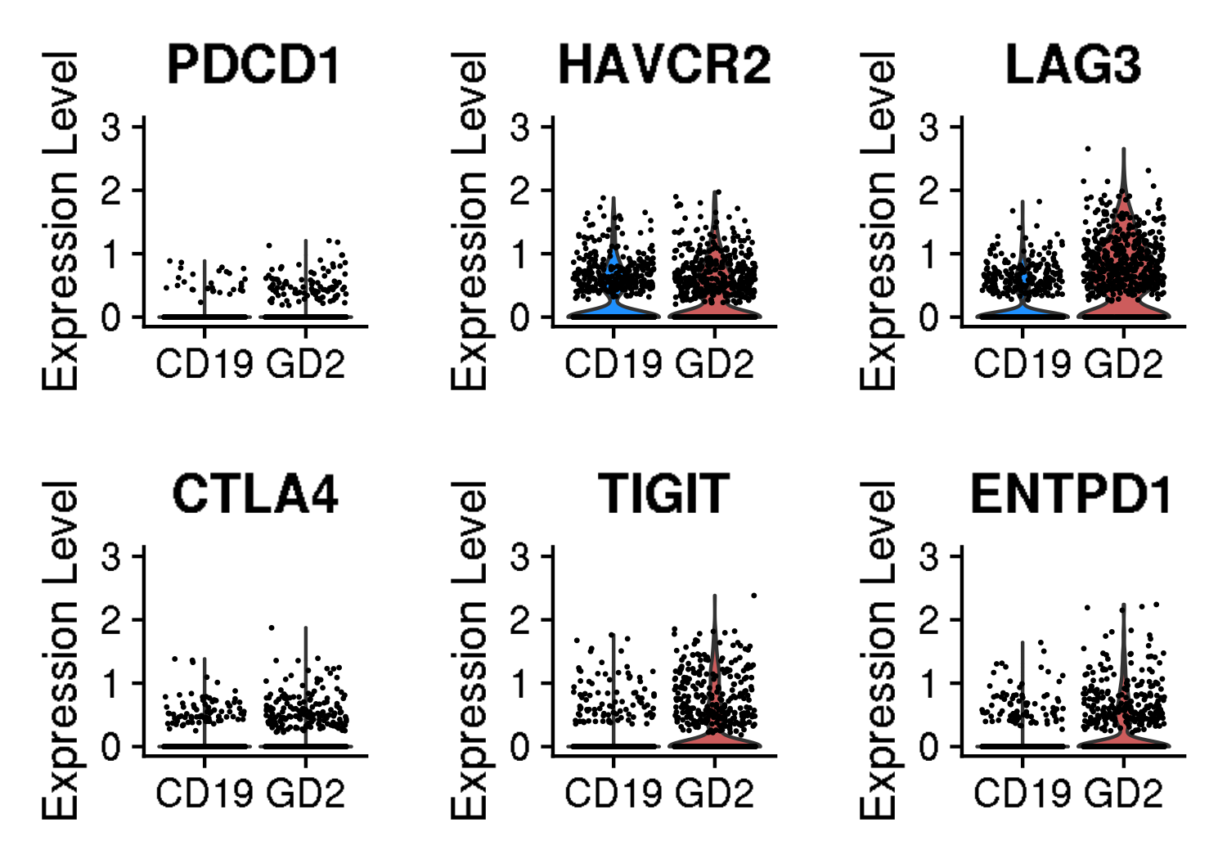
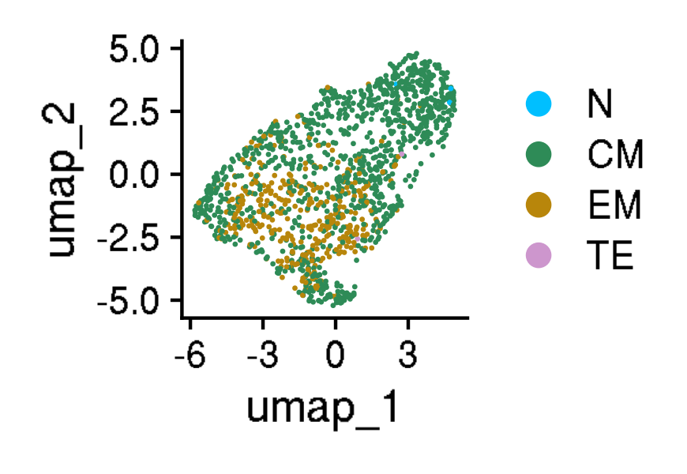
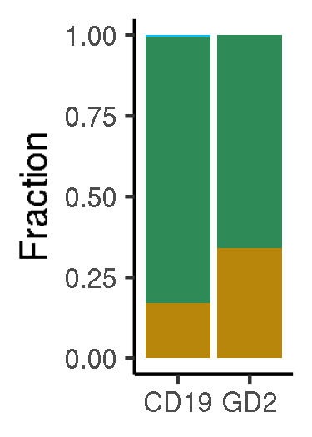
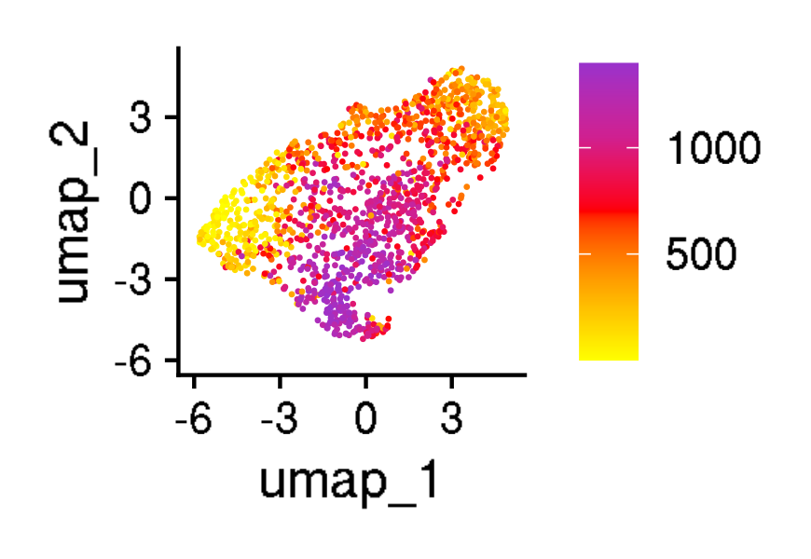
Validation of CARTEx signature in another CAR T cell exhaustion model
GSE136874: 1,397 CD8+ CAR T cells at day 10 of cell culture
Functional vs exhaustion-prone CAR
Cell cycle phase
CARTEx scores
CARTEx detection
Canonical markers of exhaustion
Cell type differentiation
Pseudo-time (DC1 rank)
Notes:
Hello world

Slide 10
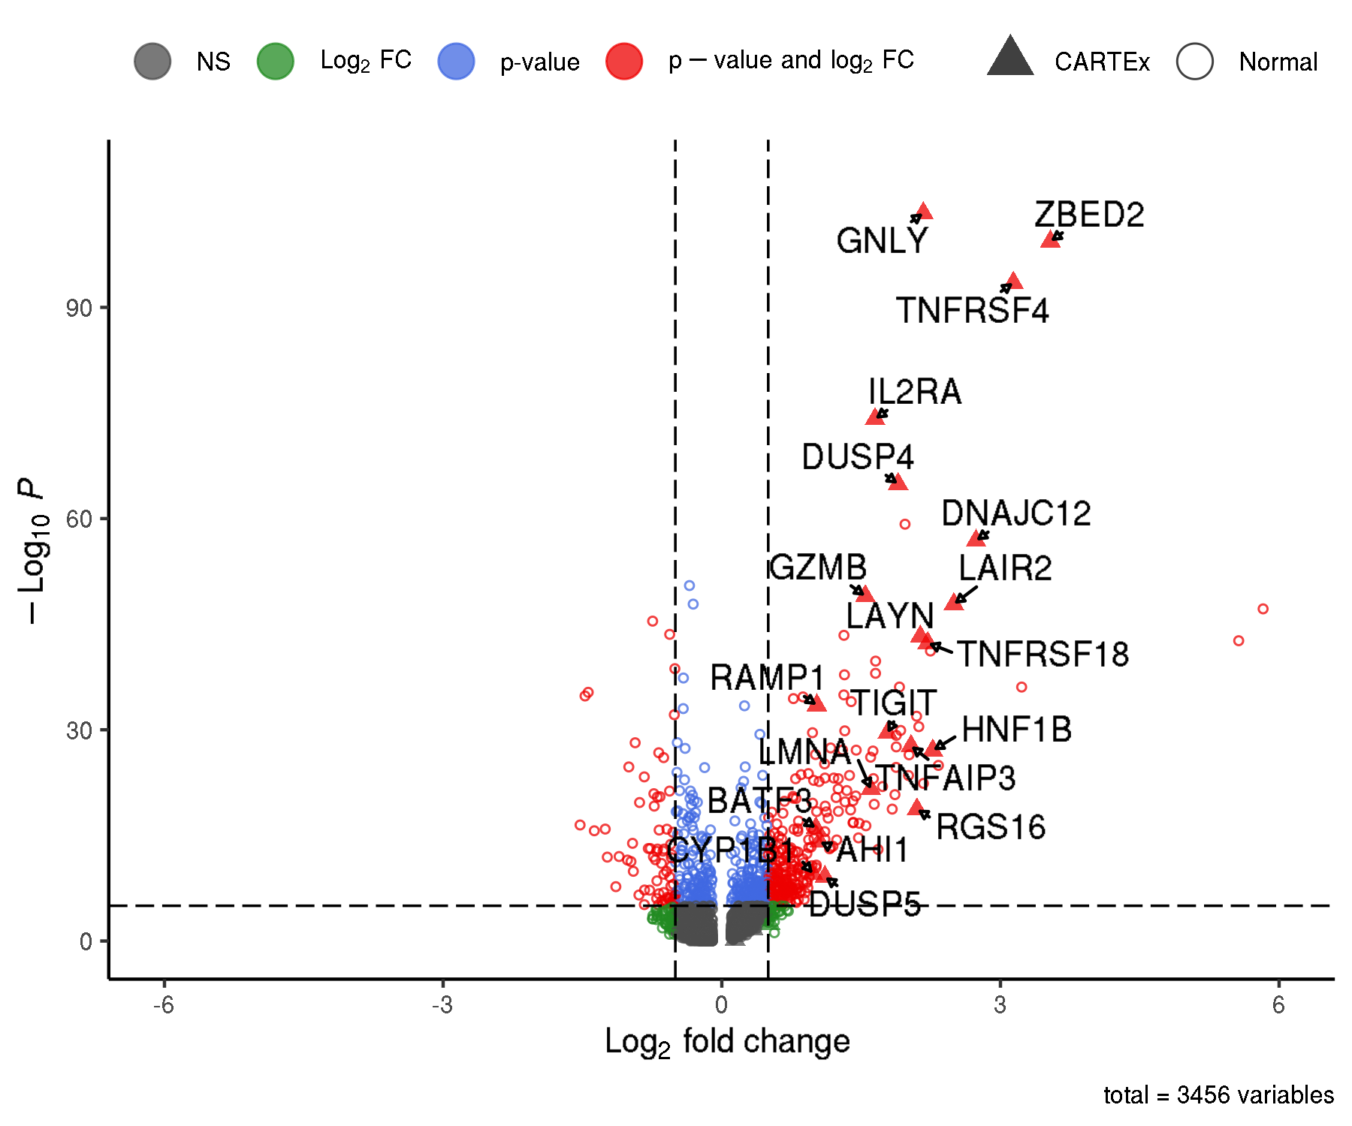
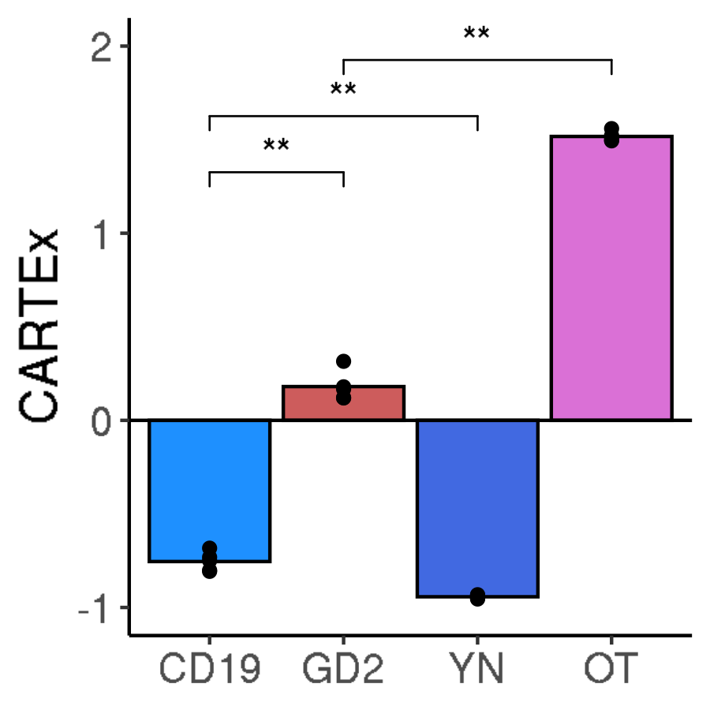
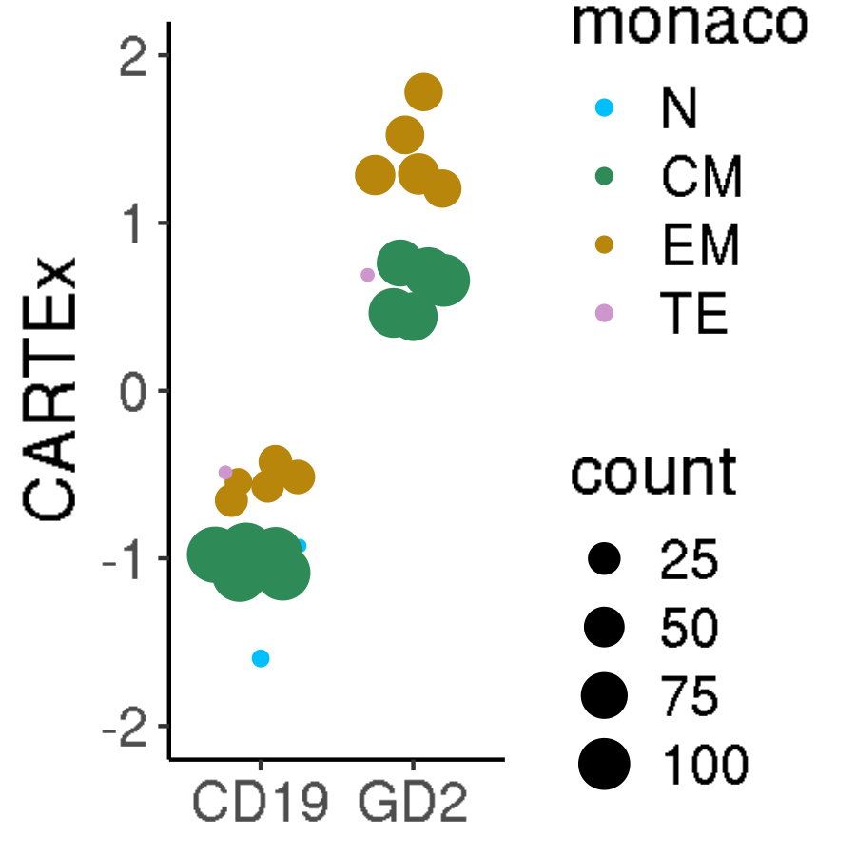
Validation of CARTEx signature in another CAR T cell exhaustion model
GSE136874: 1,397 CD8+ CAR T cells at day 10 of cell culture
Differential gene expression
Pseudo-bulk CARTEx scores
Pseudo-bulk across differentiation
Notes:
Hello world

Slide 11
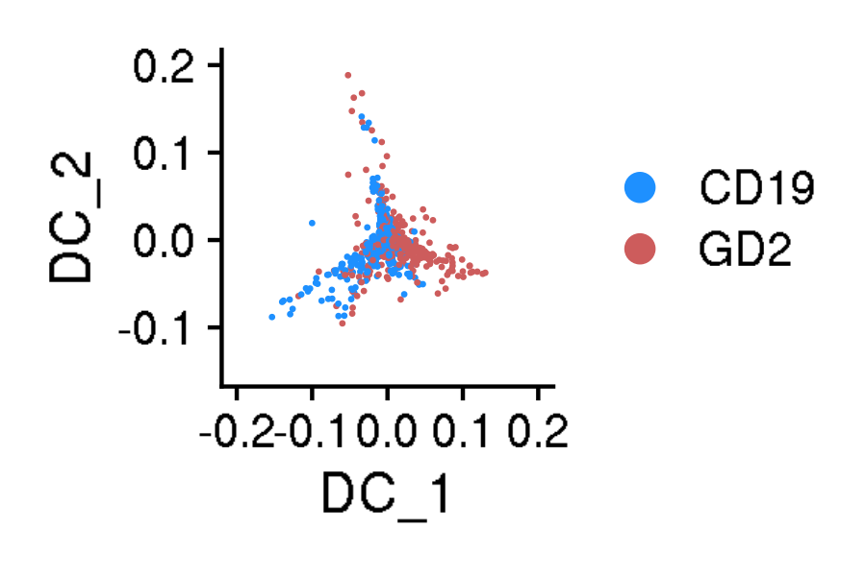
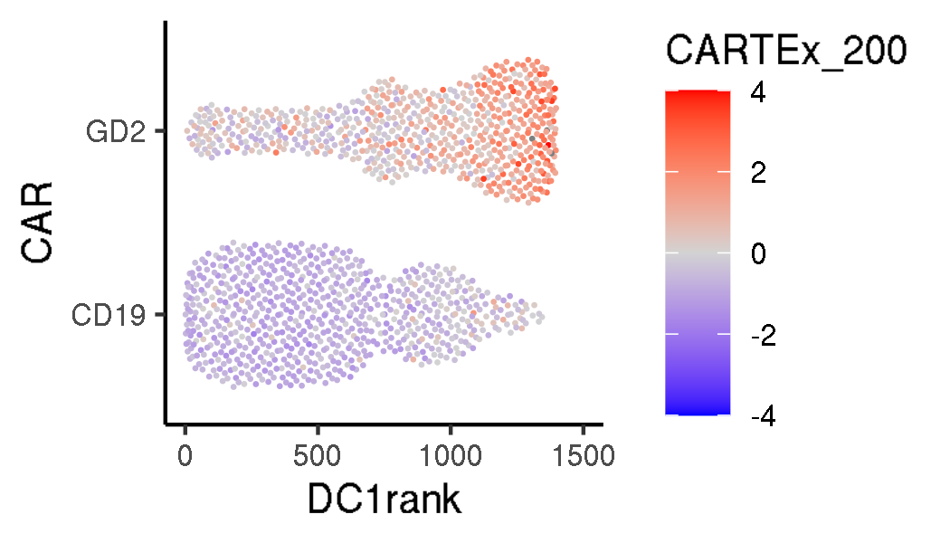
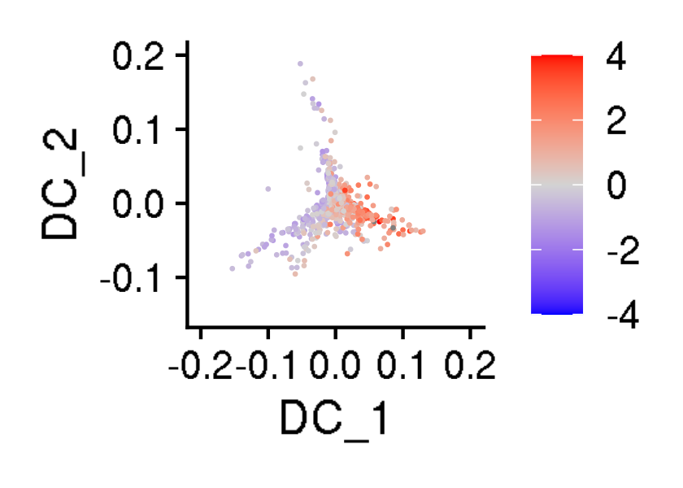
Validation of CARTEx signature in another CAR T cell exhaustion model
GSE136874: 1,397 CD8+ CAR T cells at day 10 of cell culture
Antigen exposure (diffusion)
Transition (DC1 rank)
CARTEx scores (diffusion)
Notes:
Hello world

Slide 12
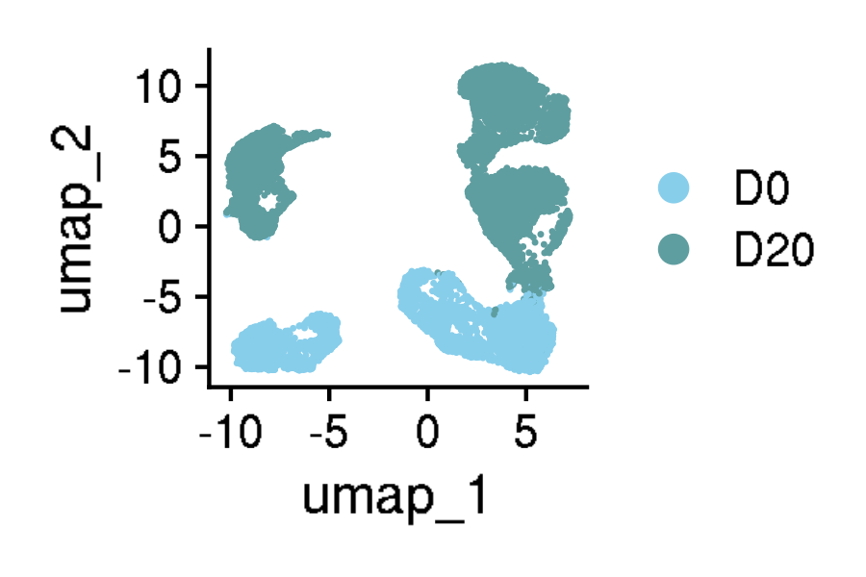
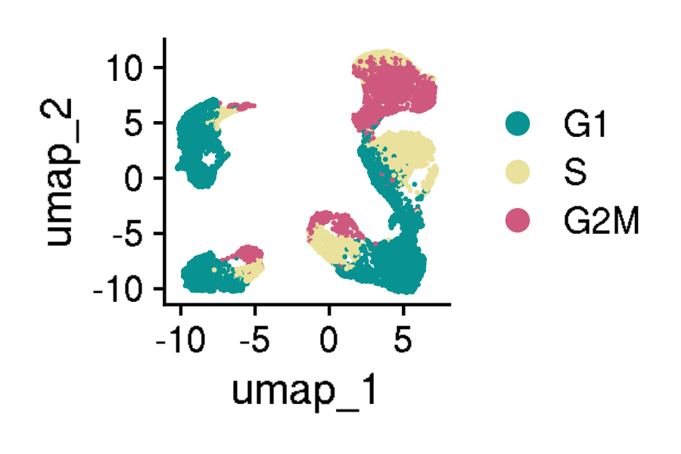
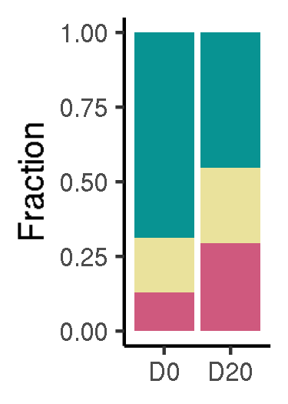
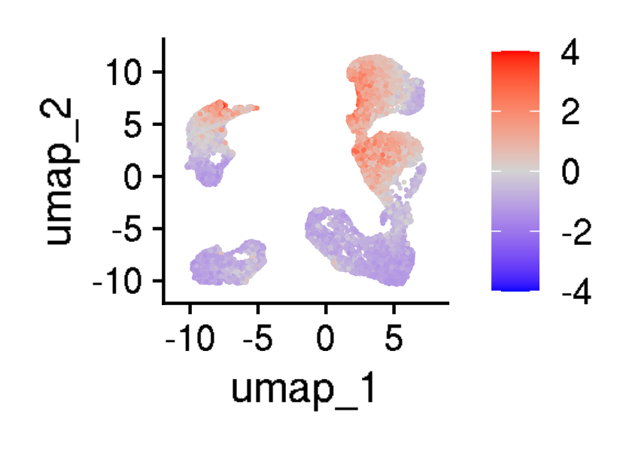





Validation of CARTEx signature in another CAR T cell exhaustion model
GSE160160: 13,039 CD8+ mesothelin (MSLN) CAR T cells across 20 days of antigen stimulation
Antigen exposure
Cell cycle phase
CARTEx scores
CARTEx detection
Canonical markers of exhaustion
Cell type differentiation
Pseudo-time (DC1 rank)
Notes:
Hello world

Slide 13



Validation of CARTEx signature in another CAR T cell exhaustion model
GSE160160: 13,039 CD8+ mesothelin (MSLN) CAR T cells across 20 days of antigen stimulation
Differential gene expression
Pseudo-bulk CARTEx scores
Pseudo-bulk across differentiation
Notes:
Hello world

Slide 14



Validation of CARTEx signature in another CAR T cell exhaustion model
GSE160160: 13,039 CD8+ mesothelin (MSLN) CAR T cells across 20 days of antigen stimulation
Antigen exposure (diffusion)
Transition (DC1 rank)
CARTEx scores (diffusion)
Notes:
Hello world

Slide 15
Validation of CARTEx signature in another CAR T cell exhaustion model
GSE160160: 13,039 CD8+ mesothelin (MSLN) CAR T cells across 20 days of antigen stimulation
Notes:
Hello world

Slide 16
Appendix
Appendix
Notes:
Hello world

Slide 17








GSE136874: Functional vs exhaustion-prone CAR T cells
Appendix
CARTEx
Activation
Anergy
Senescence
Stemness
NK-like
LCMV
BBD
PD1
Notes:
Hello world

Slide 18








GSE160160: Continuous antigen exposure of CAR T cells
Appendix
CARTEx
Activation
Anergy
Senescence
Stemness
NK-like
LCMV
BBD
PD1
Notes:
Hello world

Slide 19









GSE120575: abc
Appendix
CARTEx
Activation
Anergy
Senescence
Stemness
NK-like
LCMV
BBD
PD1
Notes:
Hello world

Slide 20









GSE151511: asdasd
Appendix
CARTEx
Activation
Anergy
Senescence
Stemness
NK-like
LCMV
BBD
PD1
Notes:
Hello world

Slide 21









GSE125881: asdasd
Appendix
CARTEx
Activation
Anergy
Senescence
Stemness
NK-like
LCMV
BBD
PD1
Notes:
Hello world

Slide 22









GSE207935: asdasd
Appendix
CARTEx
Activation
Anergy
Senescence
Stemness
NK-like
LCMV
BBD
PD1
Notes:
Hello world

